Slide 1

Personality Dynamics Part 3: Workshop + BYOD
Emorie D. Beck, PhD
2nd Summer School in Personality Science, Madrid, Spain
July 6, 2022

Slide 2
Today’s Agenda
Talk
Seminar
Workshop
Linking Theory and Methods Using Dynamics
Revisiting Assessment and Its Link to Dynamics
Applying (some) Dynamic Models to Real Data
CAPS
Methods from the Talk
Reimagining personality structure
Deconstructing Definitions
(Basic) Time Series
Core Dynamics Metrics
Considering the time/context problem
Small Group Work
Multilevel “Process” Models
Revisiting the Person-Situation Debate: A New Approach to Prediction
Presentation and Integration
(Applied) Machine Learning
Dynamic EGA
Estimating the Robustness of prospective personality trait-outcome associations
(Maybe) Growth Models

Slide 3


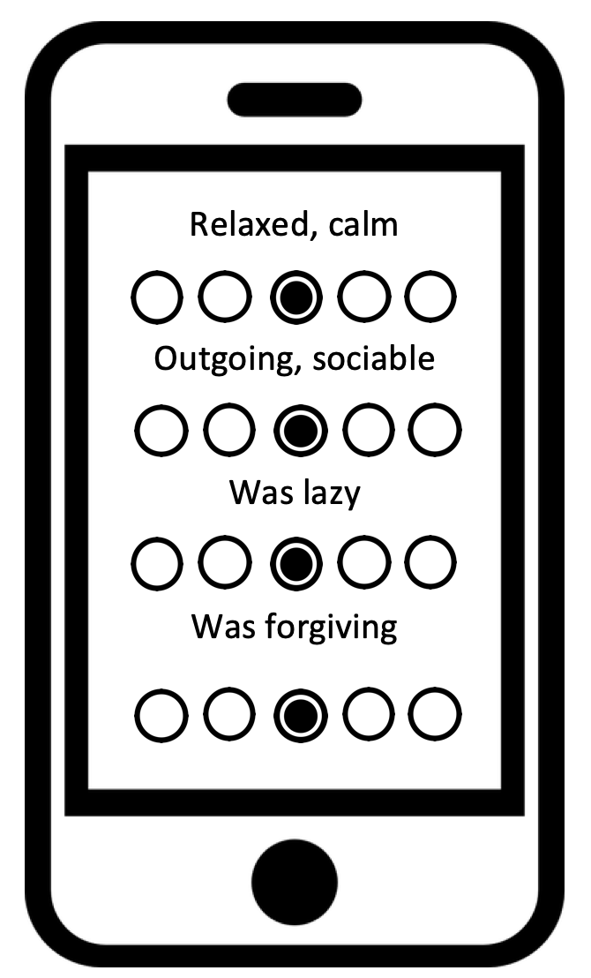




Basic Surveys
ESM / EMA
Mobile Sensing
Open-Ended Responses
Notes:
To do so, I’ve used a variety of sources of data and data collection methods, including surveys, Experience Sampling Methdology, Passive or mobile sensing, and open-ended responses from both written and spoken questions or interviews. Moreover, I frequently use these both cross-sectionally and longitudinally

Slide 4
ID | Date | Sociability | Trust | Organization | Emotional Volatility | Intellectual Curiosity
1 | 10/22/18 15:23 | 3 | 3 | 4 | 3 | 3
1 | 10/22/18 19:00
1 | 10/22/18 23:23 | 2 | 2 | 1 | 4 | 2
1 | 10/22/18 23:25 | 3 | 1 | 1 | 3 | 4
1 | 10/23/18 3:00
1 | 10/23/18 7:00
1 | 10/23/18 11:00
1 | 10/23/18 17:50 | 3 | 4 | 4 | 3 | 3
1 | 10/23/18 19:39 | 2 | 3 | 3 | 3 | 3
1 | 10/23/18 23:00
1 | 10/24/18 0:00 | 5 | 4 | 1 | 4 | 1
1 | 10/24/18 3:00
1 | 10/24/18 7:00
1 | 10/24/18 11:00
1 | 10/24/18 11:44 | 4 | 3 | 2 | 1 | 2
1 | 10/24/18 15:37 | 5 | 2 | 4 | 4 | 3

Slide 5
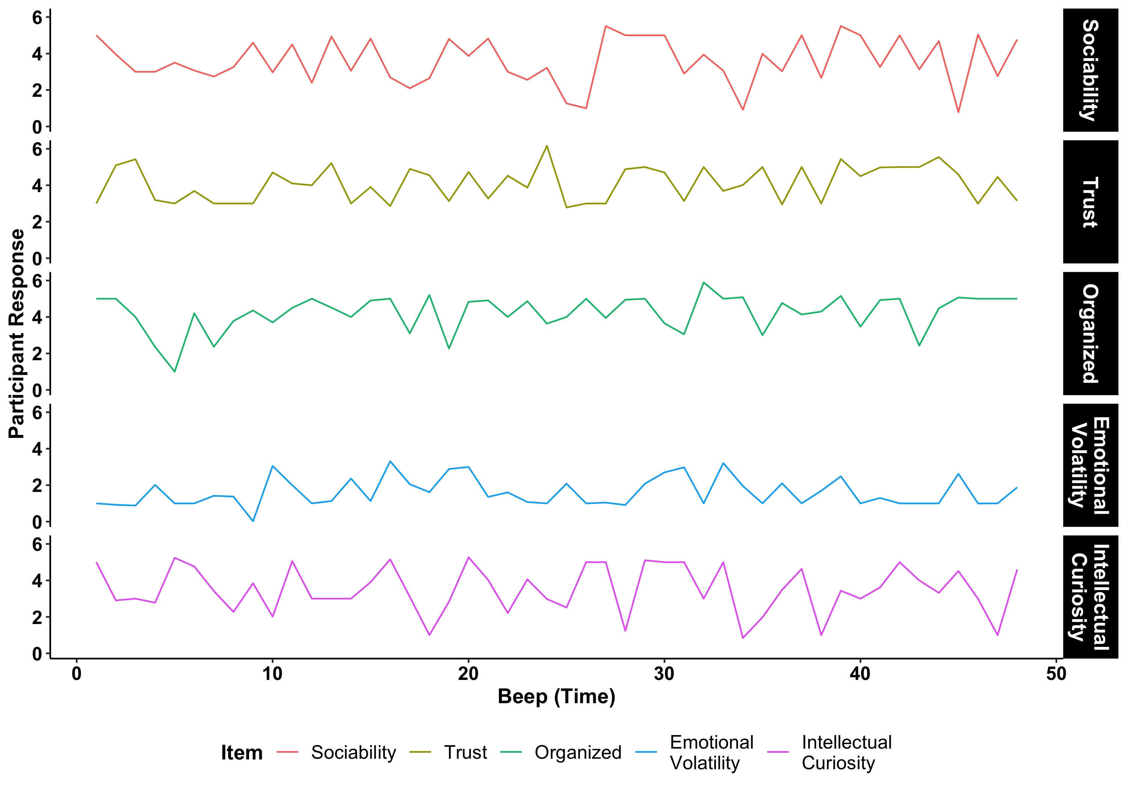
Notes:
First, the most basic descriptor of any dynamic data is what is called a time series, which is simply plotting those data with time on the x axis and whatever the observed values are on the y axis.
So imagine we collected data on these five experiences using experience sampling.

Slide 6
Notes:
We can then plot the time series of each, making it clear that these experiences vary over time and that they show different patterns of variability
From here, there a number of ways dissect the time series by trying to identify patterns of timing, examining standard deviations and other features of density distributions, and so on. One of the most simple and common ways is to simply look at correlations in how these unfold over time

Slide 7
See Boker & Martin (2018)

Slide 8
But First: Considerations
Basic / Data Driven
More Challenging / Conceptual
Do you have sufficient N?
Is your question autoregressive?
Do you have a variance or frequency problem?
Are there likely individual differences in the phenomena?
The day-night problem
How prevalent are different response styles?
What is your missingness structure?

Slide 9
But First: Considerations
Do you have sufficient N?
ID | day | beep | y₁
S1 | 1 | 1 | 1
S1 | 1 | 2 | 3
S1 | 1 | 3 | 1
S1 | 1 | 4 | 2
S2 | 1 | 1 | 2
S2 | 1 | 2 | 2
S2 | 1 | 3 | 4
S2 | 1 | 4 | 3
S1 | 2 | 1 | 1
S1 | 2 | 2 | 3
S1 | 2 | 3 | 1
S1 | 2 | 4 | 2
S2 | 2 | 1 | 1
S2 | 2 | 2 | 2
S2 | 2 | 3 | 2
S2 | 2 | 4 | 1
Between
N = 2
n₁ = 8
What Between and Within-Person N’s do you need?
Within
Depends on:
Perspective (idiographic, within-person, etc.)
Method (mean, SD, correlation)
Number of indicators
But once you choose a question and look to a method, this should be the first question you ask yourself.
n₂ = 8

Slide 10
But First: Considerations
Do you have a variance or frequency problem?
ID | day | beep | y₁ | y₂
S1 | 1 | 1 | 1 | 0
S1 | 1 | 2 | 3 | 1
S1 | 1 | 3 | 1 | 1
S1 | 1 | 4 | 2 | 0
S2 | 1 | 1 | 1 | 0
S2 | 1 | 2 | 1 | 0
S2 | 1 | 3 | 1 | 0
S2 | 1 | 4 | 1 | 1
S1 | 2 | 1 | 1 | 1
S1 | 2 | 2 | 3 | 0
S1 | 2 | 3 | 5 | 1
S1 | 2 | 4 | 2 | 0
S2 | 2 | 1 | 1 | 0
S2 | 2 | 2 | 1 | 0
S2 | 2 | 3 | 2 | 0
S2 | 2 | 4 | 1 | 0
“The method required it, but the life did not” (Allport, 1968).
S1:
SD_{y1} = 1.39
Range_{y1} = 1 to 5
y₂: 0 = 4, 1 = 4
What to do with low variances and frequencies:
Typical suggestions:
standardize (within-person)
throw out low frequency / variance folks
But the best thing you can do is design and test questions and provide instructions to participants that will provide variability in responses.
S2:
SD_{y1} = 1.39
Range = 1 to 2
y₂: 0 = 7, 1 = 1

Slide 11
But First: Considerations
The Day-Night Problem
ID | day | beep | y₁
S1 | 1 | 1 | 1
S1 | 1 | 2 | 3
S1 | 1 | 3 | 1
S1 | 1 | 4 | 2
S2 | 1 | 1 | 2
S2 | 1 | 2 | 2
S2 | 1 | 3 | 4
S2 | 1 | 4 | 3
S1 | 2 | 1 | 1
S1 | 2 | 2 | 3
S1 | 2 | 3 | 1
S1 | 2 | 4 | 2
S2 | 2 | 1 | 1
S2 | 2 | 2 | 2
S2 | 2 | 3 | 2
S2 | 2 | 4 | 1
Nighttime

Slide 12
But First: Considerations
The Day-Night Problem
ID | day | beep | y₁
S1 | 1 | 1 | 1
S1 | 1 | 2 | 3
S1 | 1 | 3 | 1
S1 | 1 | 4 | 2
S1 | 1 | 5 | NA
S2 | 1 | 1 | 2
S2 | 1 | 2 | 2
S2 | 1 | 3 | 4
S2 | 1 | 4 | 3
S2 | 1 | 5 | NA
S1 | 2 | 1 | 1
S1 | 2 | 2 | 3
S1 | 2 | 3 | 1
S1 | 2 | 4 | 2
S1 | 2 | 5 | NA
S2 | 2 | 1 | 1
S2 | 2 | 2 | 2
S2 | 2 | 3 | 2
S2 | 2 | 4 | 1
S2 | 2 | 5 | NA
What to do with overnight intervals
Nighttime
Typical suggestions:
Add empty rows
Cubic spline interpolation
Linear normalization
Ignore them (if not asking autoregressive questions)

Slide 13
But First: Considerations
What is your missingness structure?
ID | Day | Beep | Sociability | Trust | Organization | Emotional Volatility | Intellectual Curiosity
1 | 1 | 1 | 3 | 3 | 4 | 3 | 3
1 | 1 | 2 | 2 | 2 | 1 | 4 | 2
1 | 1 | 3 | 3 | 1 | 1 | 3 | 4
1 | 1 | 4 | 3 | 4 | 4 | 3 | 3
2 | 1 | 1 | 2 | 3 | 3 | NA | 3
2 | 1 | 2 | 5 | 4 | 1 | NA | 1
2 | 1 | 3 | 4 | 3 | 2 | NA | 2
2 | 1 | 4 | 5 | 2 | 4 | NA | 3
3 | 1 | 1 | NA | NA | NA | NA | NA
3 | 1 | 2 | 4 | 2 | 3 | 1 | 3
3 | 1 | 3 | 4 | 3 | 2 | 4 | 1
3 | 1 | 4 | 3 | 2 | 3 | 2 | 2
4 | 1 | 1 | 4 | 4 | 1 | 4 | 4
4 | 1 | 2 | 2 | 2 | 2 | 4 | 3
4 | 1 | 3 | 2 | 1 | 1 | 2 | 2
4 | 1 | 4 | 4 | 3 | 0 | 4 | 4
What to do with missingness
Options
Observation-wise deletion: delete missing observations
Person-wise deletion: delete people with reporting issues
Regardless of how you deal with it, sensitivity analyses with and without those folks (or controlling for those patterns) should be conducted

Slide 14
But First: Considerations
Is your question autoregressive? The unequal interval problem
ID | day | beep | y₁ | y_{1, t-1}
S1 | 1 | 1 | 1
S1 | 1 | 2 | 3
S1 | 1 | 3 | 1
S1 | 1 | 4 | 2
S1 | 1 | 5 | NA
S1 | 2 | 1 | 1
S1 | 2 | 2 | 3
S1 | 2 | 3 | 1
S1 | 2 | 4 | 2
S1 | 2 | 5 | NA
S2 | 1 | 1 | 2
S2 | 1 | 2 | 2
S2 | 1 | 3 | 4
S2 | 1 | 4 | 3
S2 | 1 | 5 | NA
S2 | 2 | 1 | 1
S2 | 2 | 2 | 2
S2 | 2 | 3 | 2
S2 | 2 | 4 | 1
S2 | 2 | 5 | NA
Lagged Indicator

Slide 15
But First: Considerations
Is your question autoregressive? The unequal interval problem
ID | day | beep | y₁ | y_{1, t-1}
S1 | 1 | 1 | 1 | NA
S1 | 1 | 2 | 3 | 1
S1 | 1 | 3 | 1 | 3
S1 | 1 | 4 | 2 | 1
S1 | 1 | 5 | NA | 2
S1 | 2 | 1 | 1 | NA
S1 | 2 | 2 | 3 | 1
S1 | 2 | 3 | 1 | 3
S1 | 2 | 4 | 2 | 1
S1 | 2 | 5 | NA | 2
S2 | 1 | 1 | 2 | NA
S2 | 1 | 2 | 2 | 2
S2 | 1 | 3 | 4 | 2
S2 | 1 | 4 | 3 | 4
S2 | 1 | 5 | NA | 3
S2 | 2 | 1 | 1 | NA
S2 | 2 | 2 | 2 | 1
S2 | 2 | 3 | 2 | 2
S2 | 2 | 4 | 1 | 2
S2 | 2 | 5 | NA | 1
Lagged Indicator

Slide 16
But First: Considerations
Are there likely individual differences in the phenomena?
ID | day | beep | y₁ | y_{1, t-1}
S1 | 1 | 1 | 1
S1 | 1 | 2 | 3
S1 | NA | NA | NA
S1 | 1 | 4 | 2
S1 | 1 | 5 | NA
S1 | 2 | 1 | 1
S1 | NA | NA | NA
S1 | 2 | 3 | 1
S1 | 2 | 4 | 2
S1 | 2 | 5 | NA
S2 | 1 | 1 | 2
S2 | 1 | 2 | 2
S2 | 1 | 3 | 4
S2 | 1 | 4 | 3
S2 | 1 | 5 | NA
S2 | 2 | 1 | 1
S2 | 2 | 2 | 2
S2 | 2 | 3 | 2
S2 | 2 | 4 | 1
S2 | 2 | 5 | NA

Slide 17
But First: Considerations
Are there likely individual differences in the phenomena?
ID | day | beep | y₁ | y_{1, t-1}
S1 | 1 | 1 | 1 | NA
S1 | 1 | 2 | 3 | 1
S1 | 1 | 4 | 2 | 3
S1 | 1 | 5 | NA | 2
S1 | 2 | 1 | 1 | NA
S1 | 2 | 3 | 1 | 1
S1 | 2 | 4 | 2 | 1
S1 | 2 | 5 | NA | 2
S2 | 1 | 1 | 2 | NA
S2 | 1 | 2 | 2 | 2
S2 | 1 | 3 | 4 | 2
S2 | 1 | 4 | 3 | 4
S2 | 1 | 5 | NA | 3
S2 | 2 | 1 | 1 | NA
S2 | 2 | 2 | 2 | 1
S2 | 2 | 3 | 2 | 2
S2 | 2 | 4 | 1 | 2
S2 | 2 | 5 | NA | 1

Slide 18
But First: Considerations
Are there likely individual differences in the phenomena?
ID | day | beep | y₁ | y_{1, t-1}
S1 | 1 | 1 | 1 | NA
S1 | 1 | 2 | 3 | 1
S1 | 1 | 4 | 2 | 3
S1 | 1 | 5 | NA | 2
S1 | 2 | 1 | 1 | NA
S1 | 2 | 3 | 1 | 1
S1 | 2 | 4 | 2 | 1
S1 | 2 | 5 | NA | 2
S2 | 1 | 1 | 2 | NA
S2 | 1 | 2 | 2 | 2
S2 | 1 | 3 | 4 | 2
S2 | 1 | 4 | 3 | 4
S2 | 1 | 5 | NA | 3
S2 | 2 | 1 | 1 | NA
S2 | 2 | 2 | 2 | 1
S2 | 2 | 3 | 2 | 2
S2 | 2 | 4 | 1 | 2
S2 | 2 | 5 | NA | 1

Slide 19
But First: Considerations
Are there likely individual differences in the phenomena?
ID | day | beep | y₁ | y_{1, t-1}
S1 | 1 | 1 | 1 | NA
S1 | 1 | 2 | 3 | 1
S1 | NA | NA | NA | 3
S1 | 1 | 4 | 2 | NA
S1 | 1 | 5 | NA | 2
S1 | 2 | 1 | 1 | NA
S1 | NA | NA | NA | 1
S1 | 2 | 3 | 1 | NA
S1 | 2 | 4 | 2 | 1
S1 | 2 | 5 | NA | 2
S2 | 1 | 1 | 2 | NA
S2 | 1 | 2 | 2 | 2
S2 | 1 | 3 | 4 | 2
S2 | 1 | 4 | 3 | 4
S2 | 1 | 5 | NA | 3
S2 | 2 | 1 | 1 | NA
S2 | 2 | 2 | 2 | 1
S2 | 2 | 3 | 2 | 2
S2 | 2 | 4 | 1 | 2
S2 | 2 | 5 | NA | 1

Slide 20
But First: Considerations
Are there likely individual differences in the phenomena?
ID | day | beep | y₁ | y_{1, t-1}
S1 | 1 | 1 | 1 | NA
S1 | 1 | 2 | 3 | 1
S1 | NA | NA | NA | 3
S1 | 1 | 4 | 2 | NA
S1 | 1 | 5 | NA | 2
S1 | 2 | 1 | 1 | NA
S1 | NA | NA | NA | 1
S1 | 2 | 3 | 1 | NA
S1 | 2 | 4 | 2 | 1
S1 | 2 | 5 | NA | 2
S2 | 1 | 1 | 2 | NA
S2 | 1 | 2 | 2 | 2
S2 | 1 | 3 | 4 | 2
S2 | 1 | 4 | 3 | 4
S2 | 1 | 5 | NA | 3
S2 | 2 | 1 | 1 | NA
S2 | 2 | 2 | 2 | 1
S2 | 2 | 3 | 2 | 2
S2 | 2 | 4 | 1 | 2
S2 | 2 | 5 | NA | 1
What to do with unequal intervals:
Options:
Don’t lag (best) and use alternative model
Cubic spline interpolation
Linear normalization
Once data are collected, they are what they are. Better to design a study that minimizes unequal lags if basic lagged (often AR(1)) questions are your goal

Slide 21
Exercise 1:
Working with Time Series

Slide 22
But First: Considerations
How prevalent are different response styles?
Are restrictions in variance reflective of participants’ actual experiences or of response styles?
ID | day | beep | y₁ | y_{1, t-1}
S1 | 1 | 1 | 4
S1 | 1 | 2 | 3
S1 | 1 | 3 | 4
S1 | 1 | 4 | 2
S1 | 1 | 5 | NA
S1 | 2 | 1 | 4
S1 | 2 | 2 | 3
S1 | 2 | 3 | 4
S1 | 2 | 4 | 2
S1 | 2 | 5 | NA
S2 | 1 | 1 | 1
S2 | 1 | 2 | 2
S2 | 1 | 3 | 4
S2 | 1 | 4 | 3
S2 | 1 | 5 | NA
S2 | 2 | 1 | 1
S2 | 2 | 2 | 5
S2 | 2 | 3 | 2
S2 | 2 | 4 | 4
S2 | 2 | 5 | NA
What to do with response styles:
Options:
Best to tackle this at the collection stage
Once data are collected, they are what they are. Good instructions on how you want participants to interpret and use scales can alleviate this issue. Different response styles may be interesting, but they will hamper inference.

Slide 23
Statistical Methods
Basic / Univariate
Advanced / Multivariate
Univariate: Variability, Instability, Inertia
Cross-Lagged VAR, GIMME, and EGA
Bi/Multivariate: Correlations and (Basic) Structural Models
Machine Learning
Variance Decomposition: Multilevel Models
Differential Equation Models

Slide 24
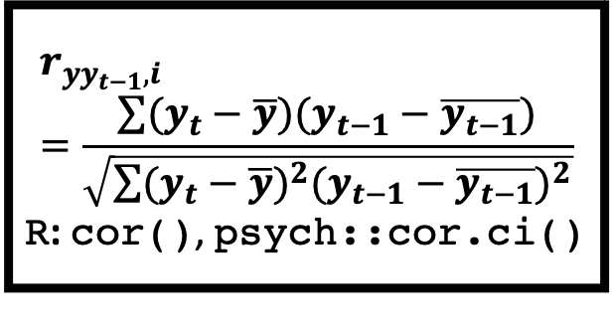
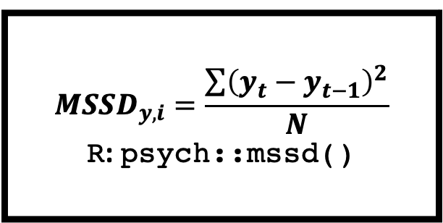
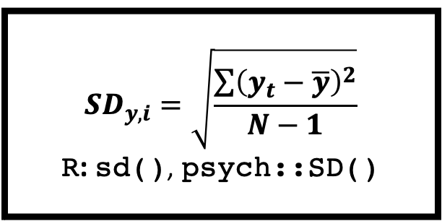
Statistical Methods
Univariate: Variability, Instability, Inertia
ID | day | beep | y₁ | y_{1, t-1}
S1 | 1 | 1 | 1 | NA
S1 | 1 | 2 | 3 | 1
S1 | 1 | 3 | 1 | 3
S1 | 1 | 4 | 2 | 1
S1 | 1 | 5 | NA | 2
S1 | 2 | 1 | 1 | NA
S1 | 2 | 2 | 3 | 1
S1 | 2 | 3 | 1 | 3
S1 | 2 | 4 | 2 | 1
S1 | 2 | 5 | NA | 2
S2 | 1 | 1 | 2 | NA
S2 | 1 | 2 | 2 | 2
S2 | 1 | 3 | 4 | 2
S2 | 1 | 4 | 3 | 4
S2 | 1 | 5 | NA | 3
S2 | 2 | 1 | 1 | NA
S2 | 2 | 2 | 2 | 1
S2 | 2 | 3 | 2 | 2
S2 | 2 | 4 | 1 | 2
S2 | 2 | 5 | NA | 1
Intraindividual Variability: the standard deviation of an indicator
$${SD}_{y,i}=\sqrt{\frac{\sum{{\left(y_{t}−\overline{y}\right)}^{2}}}{N−1}}$$
R: sd(), psych::SD()
Instability: mean squared successive difference (MSSD)
$${MSSD}_{y,i}=\frac{\sum{{\left(y_{t}−y_{t−1}\right)}^{2}}}{N}$$
R: psych::mssd()
Inertia: the univariate, lagged autocorrelation
$$r_{yy_{t−1},i}=\frac{\sum{(y_{t}−\overline{y})(y_{t−1}−\overline{y_{t−1}})}}{\sqrt{\sum{{(y_{t}−\overline{y})}^{2}{(y_{t−1}−\overline{y_{t−1}})}^{2}}}}$$
R: cor(), psych::cor.ci()
See Ong & Ram (2017)

Slide 25
Statistical Methods
Univariate: Variability, Instability, Inertia
ID | SD_{y} | MSSD_{y} | r_{y,yt-1}
S1 | 1.07 | 0.94 | 0.12
S2 | 0.88 | 1.28 | -0.35
S3 | 0.91 | 1.39 | -0.25
S4 | 1.55 | 2.98 | 0.12
S5 | 0.93 | 1.02 | -0.08
S6 | 0.99 | 0.52 | 0.03
S7 | 0.81 | 1.05 | -0.11
S8 | 1.05 | 1.17 | 0.18
S9 | 1.03 | 0.91 | 0.38
S10 | 1.06 | 1.01 | 0.29

Slide 26
Exercise 2:
Basic Dynamic Indices

Slide 27
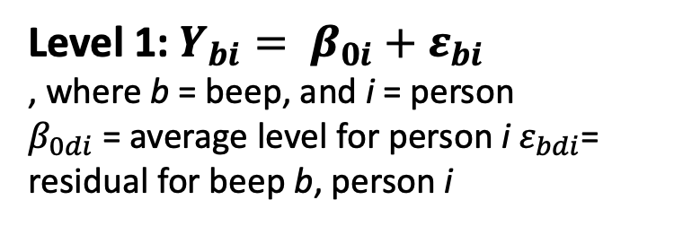
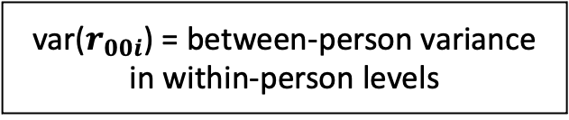
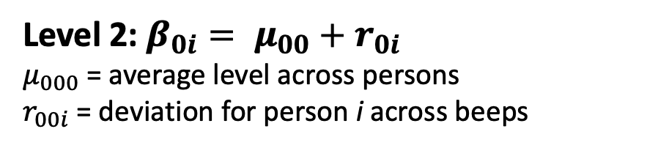
Statistical Methods
Variance Decomposition: Multilevel Models
ID | day | beep | y₁
S1 | 1 | 1 | 1
S1 | 1 | 2 | 3
S1 | 1 | 3 | 1
S1 | 1 | 4 | 2
S1 | 1 | 5 | NA
S2 | 1 | 1 | 2
S2 | 1 | 2 | 2
S2 | 1 | 3 | 4
S2 | 1 | 4 | 3
S2 | 1 | 5 | NA
S1 | 2 | 1 | 1
S1 | 2 | 2 | 3
S1 | 2 | 3 | 1
S1 | 2 | 4 | 2
S1 | 2 | 5 | NA
S2 | 2 | 1 | 1
S2 | 2 | 2 | 2
S2 | 2 | 3 | 2
S2 | 2 | 4 | 1
S2 | 2 | 5 | NA
Level 1: $Y_{bi}= β_{0i}+ε_{bi}$
, where b = beep, and i = person
$β_{0di}$ = average level for person i $ε_{bdi}$= residual for beep b, person i
Observations
Level 2: $β_{0i}= μ_{00}+r_{0i}$
$μ_{000}$ = average level across persons
$r_{00i}$= deviation for person i across beeps
Person
var($r_{00i}$) = between-person variance in within-person levels
lme4::lmer(y ~ 1 + (1 | ID), data = d)
See Haan-Rietdijk et al., 2016
Notes:
https://www.frontiersin.org/articles/10.3389/fpsyg.2016.00891/full

Slide 28
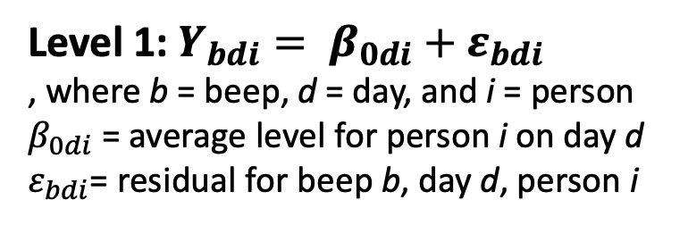
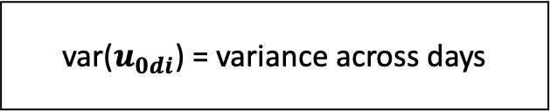
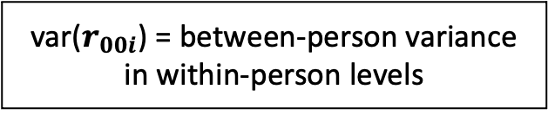
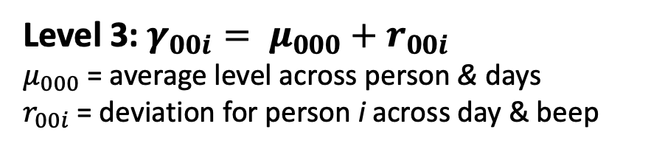
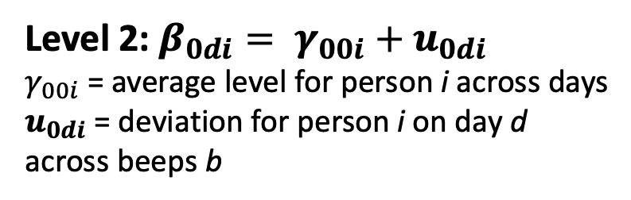
Statistical Methods
Variance Decomposition: Multilevel Models
ID | day | beep | y₁
S1 | 1 | 1 | 1
S1 | 1 | 2 | 3
S1 | 1 | 3 | 1
S1 | 1 | 4 | 2
S1 | 1 | 5 | NA
S2 | 1 | 1 | 2
S2 | 1 | 2 | 2
S2 | 1 | 3 | 4
S2 | 1 | 4 | 3
S2 | 1 | 5 | NA
S1 | 2 | 1 | 1
S1 | 2 | 2 | 3
S1 | 2 | 3 | 1
S1 | 2 | 4 | 2
S1 | 2 | 5 | NA
S2 | 2 | 1 | 1
S2 | 2 | 2 | 2
S2 | 2 | 3 | 2
S2 | 2 | 4 | 1
S2 | 2 | 5 | NA
Level 1: $Y_{bdi}= β_{0di}+ε_{bdi}$
, where b = beep, d = day, and i = person
$β_{0di}$ = average level for person i on day d
$ε_{bdi}$= residual for beep b, day d, person i
Observations
Day
Level 2: $β_{0di}= γ_{00i}+u_{0di}$
$γ_{00i}$ = average level for person i across days
$u_{0di}$ = deviation for person i on day d across beeps b
Person
Level 3: $γ_{00i}= μ_{000}+r_{00i}$
$μ_{000}$ = average level across person & days
$r_{00i}$= deviation for person i across day & beep
var($r_{00i}$) = between-person variance in within-person levels
var($u_{0di}$) = variance across days
lme4::lmer(y ~ 1 + (1 | ID/day), data = d)
See Haan-Rietdijk et al., 2016
Notes:
https://www.frontiersin.org/articles/10.3389/fpsyg.2016.00891/full

Slide 29
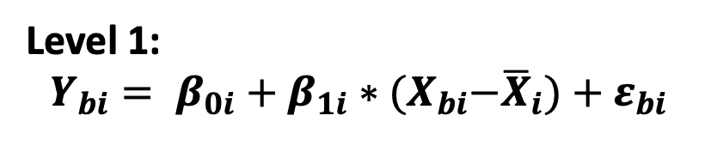
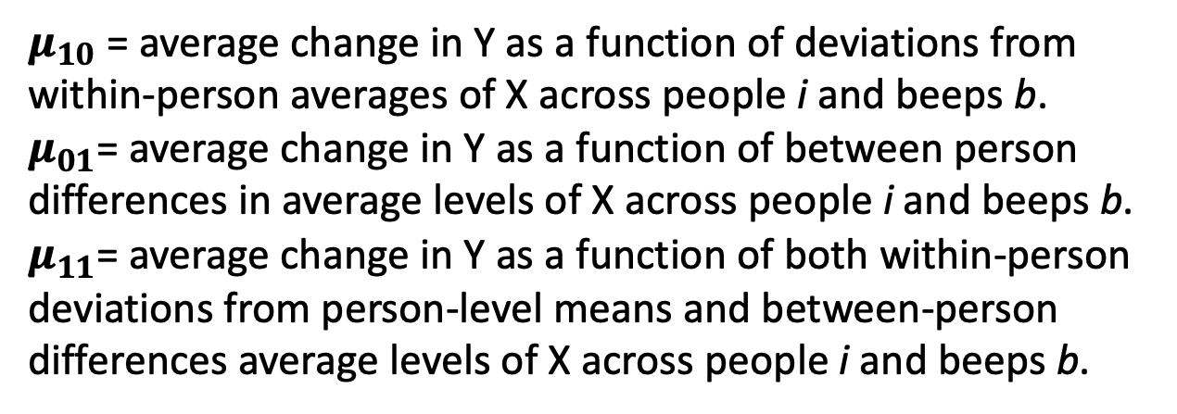
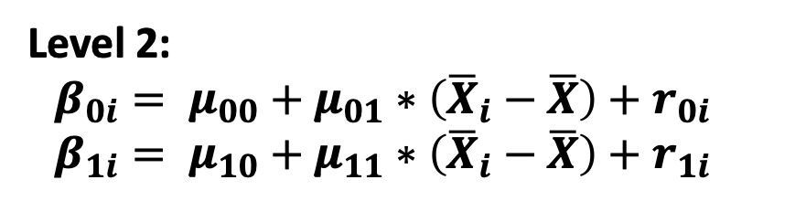
Statistical Methods
Variance Decomposition: Multilevel Models
ID | day | beep | y₁
S1 | 1 | 1 | 1
S1 | 1 | 2 | 3
S1 | 1 | 3 | 1
S1 | 1 | 4 | 2
S1 | 1 | 5 | NA
S2 | 1 | 1 | 2
S2 | 1 | 2 | 2
S2 | 1 | 3 | 4
S2 | 1 | 4 | 3
S2 | 1 | 5 | NA
S1 | 2 | 1 | 1
S1 | 2 | 2 | 3
S1 | 2 | 3 | 1
S1 | 2 | 4 | 2
S1 | 2 | 5 | NA
S2 | 2 | 1 | 1
S2 | 2 | 2 | 2
S2 | 2 | 3 | 2
S2 | 2 | 4 | 1
S2 | 2 | 5 | NA
Observations
Level 1:
$$Y_{bi}= β_{0i}+β_{1i}∗{(X}_{bi}−{\overline{X}}_{i})+ε_{bi}$$
Level 2:
$$β_{0i}= μ_{00}+μ_{01}∗\left({\overline{X}}_{i}−\overline{X}\right)+r_{0i}$$
$$β_{1i}= μ_{10}+μ_{11}∗\left({\overline{X}}_{i}−\overline{X}\right)+r_{1i}$$
Person
$μ_{10}$ = average change in Y as a function of deviations from within-person averages of X across people i and beeps b.
$μ_{01}$= average change in Y as a function of between person differences in average levels of X across people i and beeps b.
$μ_{11}$= average change in Y as a function of both within-person deviations from person-level means and between-person differences average levels of X across people i and beeps b.
See Gordon (2018) for a tutorial PDF
Notes:
https://www.frontiersin.org/articles/10.3389/fpsyg.2016.00891/full

Slide 30
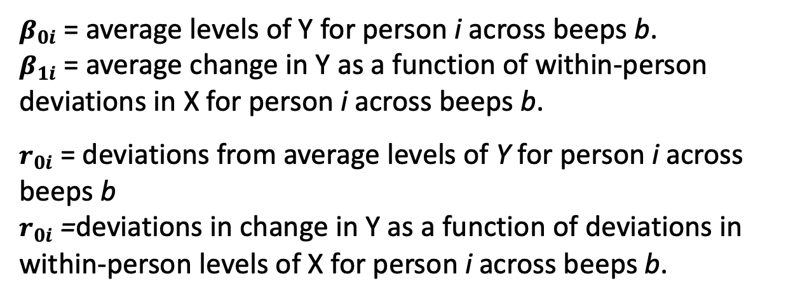
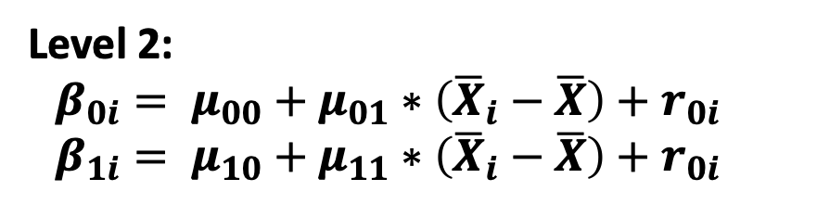
Statistical Methods
Variance Decomposition: Multilevel Models
ID | day | beep | y₁
S1 | 1 | 1 | 1
S1 | 1 | 2 | 3
S1 | 1 | 3 | 1
S1 | 1 | 4 | 2
S1 | 1 | 5 | NA
S2 | 1 | 1 | 2
S2 | 1 | 2 | 2
S2 | 1 | 3 | 4
S2 | 1 | 4 | 3
S2 | 1 | 5 | NA
S1 | 2 | 1 | 1
S1 | 2 | 2 | 3
S1 | 2 | 3 | 1
S1 | 2 | 4 | 2
S1 | 2 | 5 | NA
S2 | 2 | 1 | 1
S2 | 2 | 2 | 2
S2 | 2 | 3 | 2
S2 | 2 | 4 | 1
S2 | 2 | 5 | NA
Observations
Level 1:
$$Y_{bi}= β_{0i}+β_{1i}∗{(X}_{bi}−{\overline{X}}_{i})+ε_{bi}$$
Level 2:
$$β_{0i}= μ_{00}+μ_{01}∗\left({\overline{X}}_{i}−\overline{X}\right)+r_{0i}$$
$$β_{1i}= μ_{10}+μ_{11}∗\left({\overline{X}}_{i}−\overline{X}\right)+r_{0i}$$
Person
$β_{0i}$ = average levels of Y for person i across beeps b.
$β_{1i}$ = average change in Y as a function of within-person deviations in X for person i across beeps b.
$r_{0i}$ = deviations from average levels of Y for person i across beeps b
$r_{0i}$ =deviations in change in Y as a function of deviations in within-person levels of X for person i across beeps b.
See Gordon (2018) for a tutorial PDF
Notes:
https://www.frontiersin.org/articles/10.3389/fpsyg.2016.00891/full

Slide 31




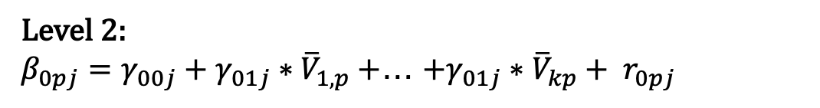
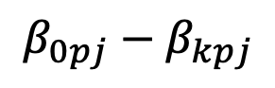
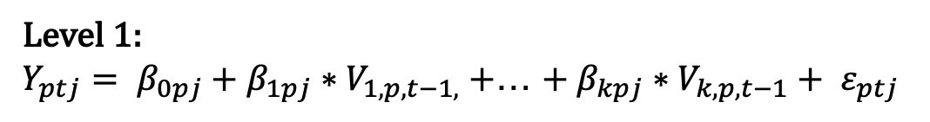
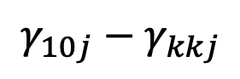
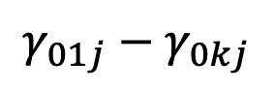
GSOEP
HILDA
SHP
BHPS
LISS
Multilevel VAR(1) Models
Between-Person Effects
(Level 2)
Epskamp et al., 2018
$$γ_{01j}−γ_{0kj}$$
Level 1:
$Y_{ptj}= β_{0pj}+β_{1pj}∗V_{1,p, t−1,}+$… $+ β_{kpj}∗V_{k,p, t−1}+ ε_{ptj}$
Level 2:
$β_{0pj}=γ_{00j}+γ_{01j}∗{\overline{V}}_{1,p}+$… $+γ_{01j}∗{\overline{V}}_{kp}+ r_{0pj}$
Within-Person Effects
(Level 1)
$$γ_{10j}−γ_{kkj}$$
…
…
…
…
…
…
…
$β_{kpj}=γ_{k0j}+γ_{k1j}∗{\overline{V}}_{p,1}+$… $+γ_{kkj}∗{\overline{V}}_{pj}+ r_{kpj}$
Person-Specific Effects
(Level 2 random effects)
$$β_{0pj}−β_{kpj}$$
*Cheung, *Beck, Thapa, & Jackson (under review)

Slide 32
Exercise 3:
Variance Decomposition
with MLM (+ Break)

Slide 33
Statistical Methods
Machine Learning
Prediction: Does X predict Y?
Prediction: Does X predict Y?
Prediction: Does X predict Y across people?
Prediction: Does X predict Y across people?
Are there individual differences in person-specific prediction?

Slide 34
Statistical Methods
Machine Learning
Regularized (Logistic) Regression
Variables
 | x₁ | x₂ | x₃ | … | x_{p}
t_{i1}
t_{i2}
t_{i3}
…
t_{in}
 | O₁
t_{i1}
t_{i2}
t_{i3}
…
t_{in}
Random Forest
P₁
Persons
P₂
P₃
…
Naïve Bayes
P_{N}
Time
BISCU(W)IT
Neural Networks
Support Vector Machines
… And more
All supported by cross-validation, regularization, ensemble methods (e.g., bagging)

Slide 35
Statistical Methods
Machine Learning
Regularized (Logistic) Regression
Variables
 | x₁ | x₂ | x₃ | … | x_{p}
t_{i1}
t_{i2}
t_{i3}
…
t_{in}
 | O₁
t_{i1}
t_{i2}
t_{i3}
…
t_{in}
Random Forest
P₁
Persons
P₂
P₃
…
Naïve Bayes
P_{N}
Time
BISCU(W)IT
Neural Networks
Support Vector Machines
… And more
All supported by cross-validation, regularization, ensemble methods (e.g., bagging)

Slide 36
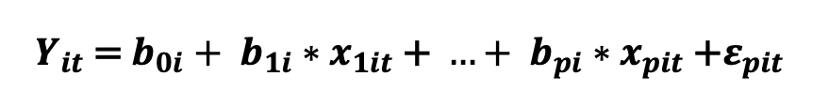
Statistical Methods
Machine Learning
Regularized (Logistic) Regression
Variables
 | x₁ | x₂ | x₃ | … | x_{p}
t_{i1}
t_{i2}
t_{i3}
…
t_{in}
 | O₁
t_{i1}
t_{i2}
t_{i3}
…
t_{in}
P₁
$$Y_{it}\text{ = }b_{0i}+ b_{1i}∗x_{1it}\text{ + }…+ b_{pi}∗x_{pit}\text{ +}ε_{pit}$$
Persons
P₂
P₃
…
P_{N}
Time
Goal: Find the best combinations of coefficients across predictors

Slide 37
Statistical Methods
Variables
Machine Learning
 | x₁ | x₂ | … | x_{p}
t_{i1}
t_{i2}
…
t_{in}
P₁
 | O₁
t_{i1}
t_{i2}
…
t_{in}
Persons
P₂
P₃
…
Regularized (Logistic) Regression
P_{N}
Time
$$Y_{it}\text{ = }b_{0i}+ b_{1i}∗x_{1it}\text{ + }…+ b_{pi}∗x_{pit}\text{ +}ε_{pit}$$
Goal: Find the best combinations of coefficients across predictors
Variables
 | x₁ | x₂ | … | x_{p}
t_{i1}
t_{i2}
…
t_{in}
P₁
 | O₁
t_{i1}
t_{i2}
…
t_{in}
Persons
P₂
P₃
…
P_{N}
The model: minimizes residuals (maximizes R² in observed data)
Time
Split the data: How consistent are the coefficients?

Slide 38
Statistical Methods
Machine Learning
Regularized (Logistic) Regression
Variables
 | x₁ | x₂ | x₃ | … | x_{p}
t_{i1}
t_{i2}
t_{i3}
…
t_{in}
 | O₁
t_{i1}
t_{i2}
t_{i3}
…
t_{in}
P₁
$$Y_{it}\text{ = }b_{0i}+ b_{1i}∗x_{1it}\text{ + }…+ b_{pi}∗x_{pit}\text{ +}ε_{pit}$$
Persons
P₂
P₃
…
P_{N}
Time
Goal: Find the best combinations of coefficients across predictors without overfitting

Slide 39
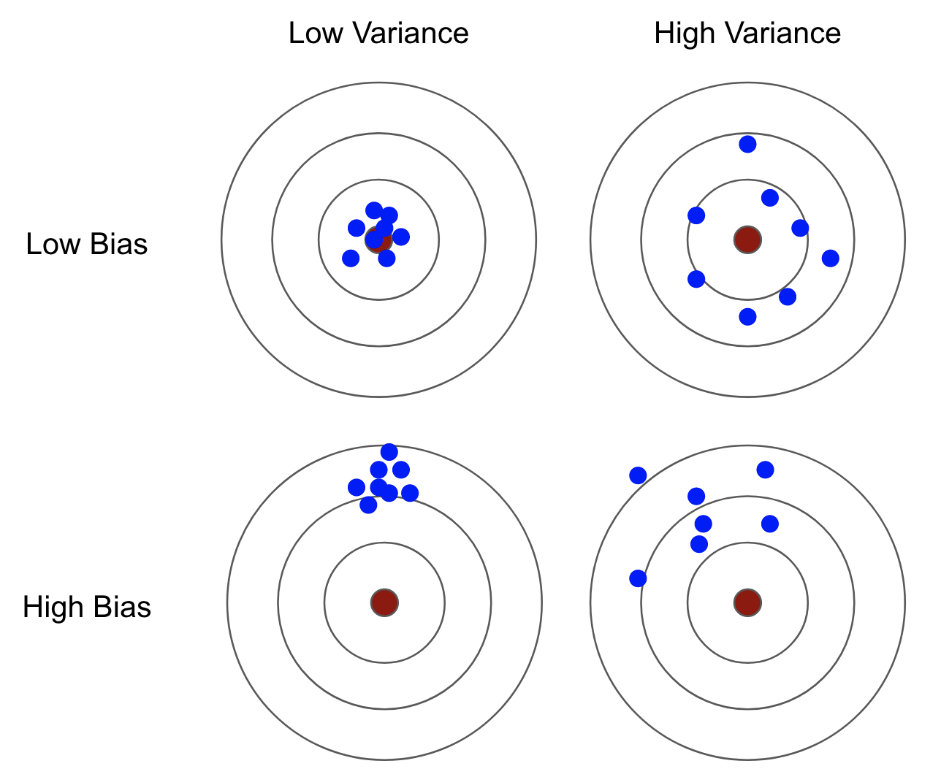
Statistical Methods
Machine Learning
The Bias-Variance Tradeoff
Bias roughly equates to model accuracy (small residuals)
Bias variance equates to the similarity in the coefficients across models fit on splits of the data

Slide 40
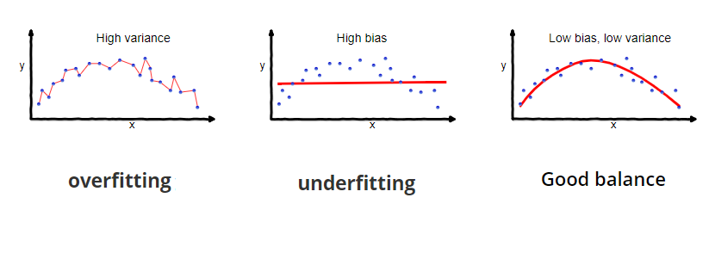
Statistical Methods
Machine Learning
The Bias-Variance Tradeoff
Bias roughly equates to model accuracy (small residuals)
Bias variance equates to the similarity in the coefficients across models fit on splits of the data

Slide 41
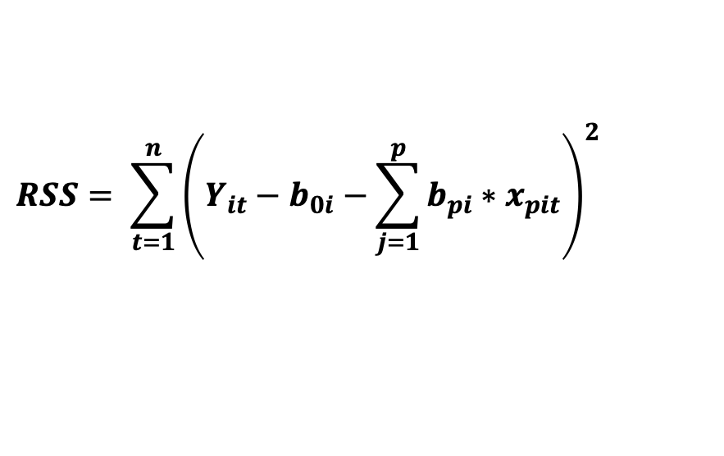
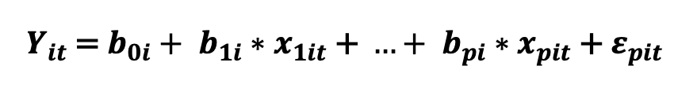
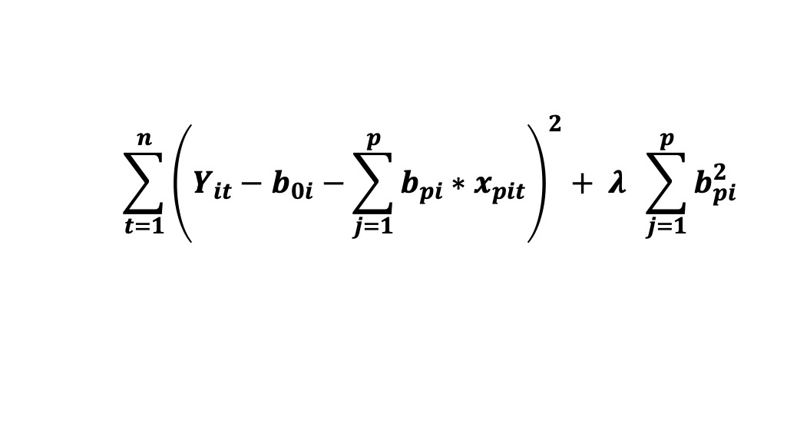
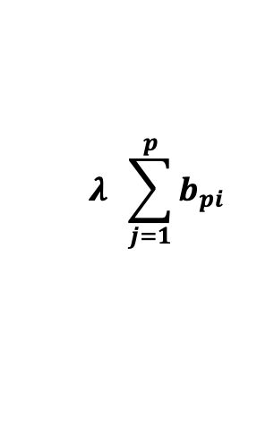
Statistical Methods
Machine Learning
Regularized (Logistic) Regression
The model:
Goal: Find the best combinations of coefficients across predictors without overfitting
$$Y_{it}\text{ = }b_{0i}+ b_{1i}∗x_{1it}\text{ + }…+ b_{pi}∗x_{pit}\text{ +}{ ε}_{pit}$$
The loss function:
$$RSS= \sum_{t=1}^{n}{{\left(Y_{it}−b_{0i}−\sum_{j=1}^{p}{b_{pi}∗x_{pit}}\right)}^{2}}$$
The penalty term (L1):
Idea: What if we penalize the coefficients to make them smaller (since non-zero associations are generally more likely)
$$λ \sum_{j=1}^{p}{b_{pi}}$$
Bringing it together, we want to minimize:
$$\sum_{t=1}^{n}{{\left(Y_{it}−b_{0i}−\sum_{j=1}^{p}{b_{pi}∗x_{pit}}\right)}^{2}+ λ \sum_{j=1}^{p}{b_{pi}^{2}}}$$

Slide 42
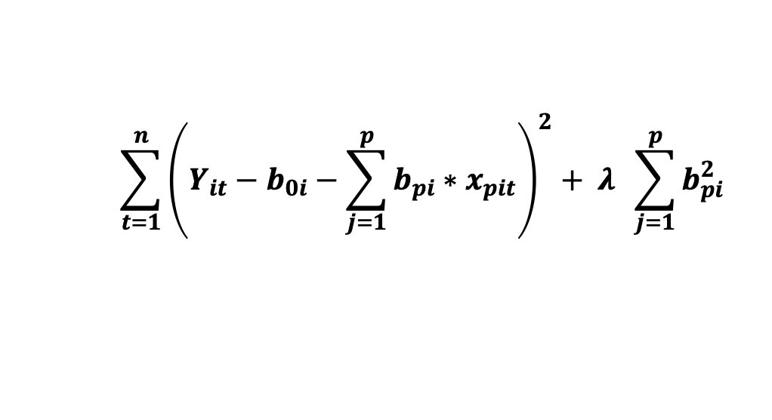

Statistical Methods
Machine Learning
Regularized (Logistic) Regression
The model:
Goal: Find the best combinations of coefficients across predictors without overfitting
$$Y_{it}\text{ = }b_{0i}+ b_{1i}∗x_{1it}\text{ + }…+ b_{pi}∗x_{pit}\text{ +}{ ε}_{pit}$$
Bringing it together, we want to minimize:
$$\sum_{t=1}^{n}{{\left(Y_{it}−b_{0i}−\sum_{j=1}^{p}{b_{pi}∗x_{pit}}\right)}^{2}+ λ \sum_{j=1}^{p}{b_{pi}^{2}}}$$
Find the best $λ$: Cross Validation!
Idea: What if we penalize the coefficients to make them smaller (since non-zero associations are generally more likely)

Slide 43
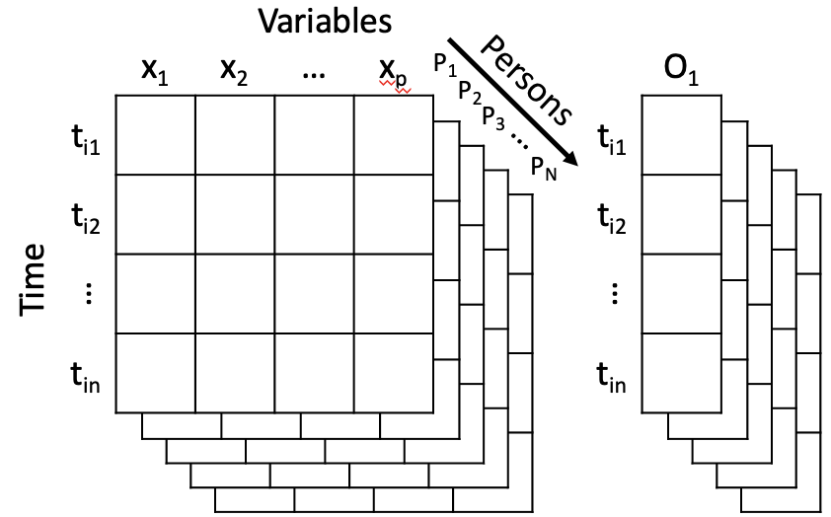
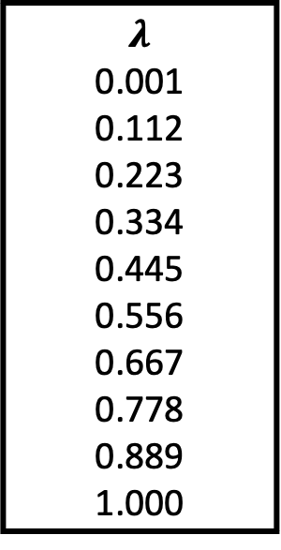
Statistical Methods
Machine Learning
$$λ$$
0.001
0.112
0.223
0.334
0.445
0.556
0.667
0.778
0.889
1.000

Slide 44
Statistical Methods
Machine Learning
Regularized (Logistic) Regression
Training
The model:
$$Y_{it}\text{ = }b_{0i}+ b_{1i}∗x_{1it}\text{ + }…+ b_{pi}∗x_{pit}\text{ +}{ ε}_{pit}$$
The loss function:
$$RSS= \sum_{t=1}^{n}{{\left(Y_{it}−b_{0i}−\sum_{j=1}^{p}{b_{pi}∗x_{pit}}\right)}^{2}}$$
Test
Goal: Find the best combinations of coefficients across predictors without overfitting in the holdout test sample

Slide 45
Exercise 4:
Prospective Prediction with Elastic Net Classification

Slide 46
Statistical Methods
Cross-Lagged VAR, GIMME, and EGA
ID | Date | V1 | V2 | V3 | V4 | V5
1 | 10/22/18 15:23 | 3 | 3 | 4 | 3 | 3
1 | 10/22/18 23:23 | 2 | 2 | 1 | 4 | 2
1 | 10/22/18 23:25 | 3 | 1 | 1 | 3 | 4
1 | 10/23/18 17:50 | 3 | 4 | 4 | 3 | 3
1 | 10/23/18 19:39 | 2 | 3 | 3 | 3 | 3
1 | 10/24/18 0:00 | 5 | 4 | 1 | 4 | 1
1 | 10/24/18 11:44 | 4 | 3 | 2 | 1 | 2
1 | 10/24/18 15:37 | 5 | 2 | 4 | 4 | 3
1 | 10/24/18 20:46 | 2 | 3 | 3 | 2 | 3
1 | 10/25/18 21:07 | 4 | 2 | 3 | 1 | 3
1 | 10/25/18 22:54 | 4 | 3 | 2 | 4 | 0
1 | 10/25/18 23:47 | 3 | 2 | 3 | 2 | 2
1 | 10/26/18 8:44 | 4 | 4 | 1 | 4 | 4
1 | 10/27/18 16:46 | 2 | 2 | 2 | 4 | 3
1 | 10/27/18 22:55 | 2 | 1 | 1 | 2 | 2
1 | 10/28/18 3:40 | 4 | 3 | 0 | 4 | 4

Slide 47
Statistical Methods
Bi/Multivariate: Correlations and (Basic) Structural Models
Raw Data
Correlations
Variables
Variables
 | V₁ | V₂ | V₃ | … | V_{p}
t_{i1}
t_{i2}
t_{i3}
…
t_{in}
 | V₁ | V₂ | V₃ | … | V_{p}
V₁ | e₁₁ | e₁₂ | e₁₃ | … | e_{1p}
V₂ | e₂₁ | e₂₂ | e₂₃ | … | e_{2p}
V₃ | e₃₁ | e₃₂ | e₃₃ | … | e_{3p}
… | … | … | … |  | …
V_{p} | e_{p1} | e_{p2} | e_{p2} | … | e_{pp}
P₁
P₁
Persons
Persons
P₂
P₂
P₃
P₃
…
…
P_{N}
P_{N}
Time
Variables
…

Slide 48
Statistical Methods
Bi/Multivariate: Correlations and (Basic) Structural Models
Factor Analysis
Dynamic Factor Analysis
psych::fa.parallel(), psych::fa()
V1
V2
V3
V4
V5
V1
0.02
-0.05 | 0.08
0.64 | -0.12 | -0.10
0.26 | -0.27 | 0.43 | 0.07
Principle Components Analysis
psych::fa.parallel(), psych::pca()
V2
V3
V4
Other clustering techniques
V5
See Beck & Jackson, 2020
Notes:
which results in a symmetric matrix of the associations among the measured variables,
which many of you may have seen represented using network tools like this
Because this is looking at patterns among an individual's expeirences over time, this could be considered a descriptive test of Allport's contention that personality is a dynamic organization within the individual.
Of course, this doesn't capture how these experiences predict each other over time, so another practice to lag the associations such that the current time point is predicted from previous time point

Slide 49
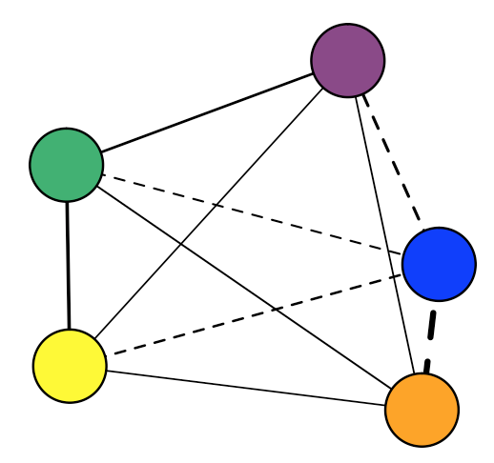
Statistical Methods
Bi/Multivariate: Correlations and (Basic) Structural Models
V1
V2
V3
V4
V5
V1
0.02
-0.05 | 0.08
0.64 | -0.12 | -0.10
0.26 | -0.27 | 0.43 | 0.07
V2
V3
V4
V5
See Beck & Jackson, 2020
Notes:
which results in a symmetric matrix of the associations among the measured variables,
which many of you may have seen represented using network tools like this
Because this is looking at patterns among an individual's expeirences over time, this could be considered a descriptive test of Allport's contention that personality is a dynamic organization within the individual.
Of course, this doesn't capture how these experiences predict each other over time, so another practice to lag the associations such that the current time point is predicted from previous time point

Slide 50
Statistical Methods
Spectral Analysis: Diurnal Cycles and more

Slide 51
Statistical Methods
Cross-Lagged VAR, GIMME, and EGA
V1
V2
V3
V4
V5
V1
0.02
-0.05 | 0.08
0.64 | -0.12 | -0.10
0.26 | -0.27 | 0.43 | 0.07
V2
V3
V4
V5
Notes:
which results in a symmetric matrix of the associations among the measured variables,
which many of you may have seen represented using network tools like this
Because this is looking at patterns among an individual's expeirences over time, this could be considered a descriptive test of Allport's contention that personality is a dynamic organization within the individual.
Of course, this doesn't capture how these experiences predict each other over time, so another practice to lag the associations such that the current time point is predicted from previous time point

Slide 52
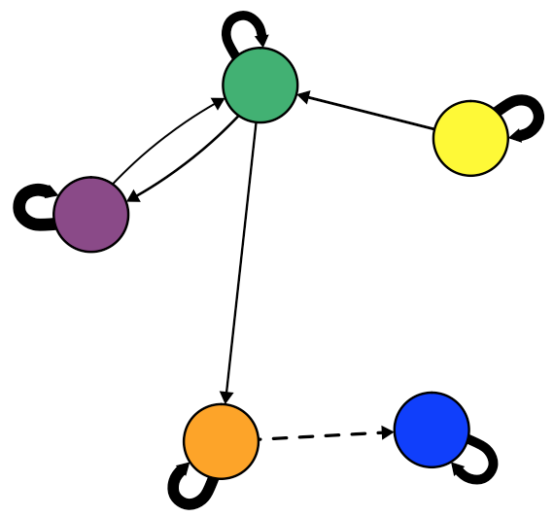
Statistical Methods
Cross-Lagged VAR, GIMME, and EGA
V1
V2
V3
V4
V5
V1
.11 | .04 | -.12 | .22 | .15
0.02 | .43 | .16 | -.20 | -.36
-0.05 | 0.08 | -.25 | -.12 | .37
0.64 | -0.12 | -0.10 | .60 | .10
0.26 | -0.27 | 0.43 | 0.07 | .33
V2
V3
V4
V5
Notes:
this results in an asymmetric correlation matrix like this that captures a different kind of dynamic structure

Slide 53
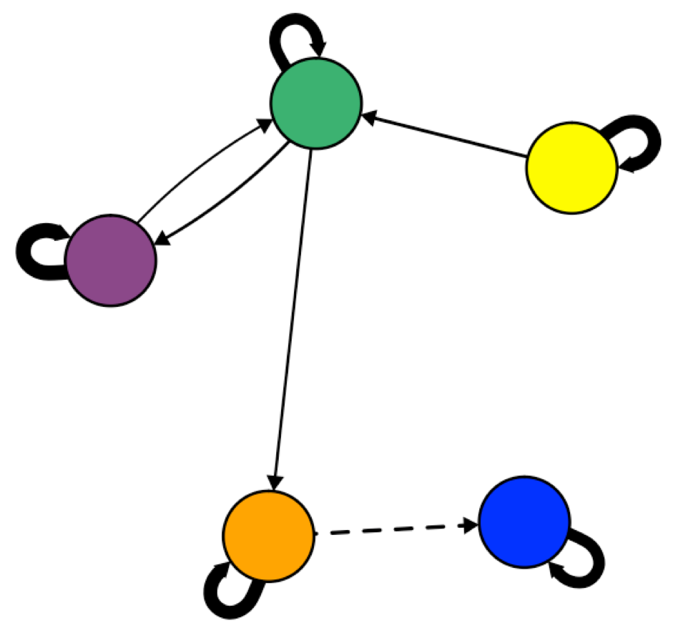
Statistical Methods
Cross-Lagged VAR, GIMME, and EGA
Notes:
And when you do this across a bunch of people, you can begin to see differences in this dynamic organization

Slide 54
Statistical Methods
Cross-Lagged VAR, GIMME, and EGA
Multilevel Vector Autoregressive Models
Graphical Vector Autoregressive Models
GIMME (Unified Structural Equation Models)
Dynamic Exploratory Graph Analysis
Between- and within-person (shrinkage)
Idiographic
Idiographic with constrained group-level pathways (by consensus)
Idiographic (with some multilevel options under development)
Frequentist or Bayesian Significance
Graphical LASSO (i.e. regularization)
Step-forward using Lagrange Multiplier Tests*
Graphical LASSO & triangulated maximally filtered graph
Between-, within-, and person-specific effects
Results in correlation terms
Sub-group analysis, moderator pathways
Uses GLLA and embedding dimensions to capture change in continuous time metrics; results as cors
mlVAR::mlVAR()
graphicalVAR::
graphicalVAR()
gimme::gimme()
EGAnet::dynEGA()
Bringmann et al., 2016
Wild et al., 2010; Epskamp et al., 2018
Beltz & Gates, 2017; Lane et al., 2019
Golino & Epskamp, 2017;
Golino et al., 2020

Slide 55
Statistical Methods
Cross-Lagged VAR, GIMME, and EGA
Multilevel Vector Autoregressive Models
Graphical Vector Autoregressive Models
GIMME (Unified Structural Equation Models)
Dynamic Exploratory Graph Analysis
Between- and within-person (shrinkage)
Idiographic
Idiographic with constrained group-level pathways (by consensus)
Idiographic (with some multilevel options under development)
Frequentist or Bayesian Significance
Graphical LASSO (i.e. regularization)
Step-forward using Lagrange Multiplier Tests
Graphical LASSO & triangulated maximally filtered graph
Between-, within-, and person-specific effects
Results in correlation terms
Sub-group analysis, moderator pathways
Uses GLLA and embedding dimensions to capture change in continuous time metrics
mlVAR::mlVAR()
graphicalVAR::
graphicalVAR()
gimme::gimme()
EGAnet::dynEGA()
Bringmann et al., 2016
Wild et al., 2010; Epskamp et al., 2018
Beltz & Gates, 2017; Lane et al., 2019
Golino & Epskamp, 2017;
Golino et al., 2020

Slide 56
Statistical Methods
Dynamic EGA
ID | Date | V1 | V2 | V3 | V4 | V5
1 | 10/22/18 15:23 | 3 | 3 | 4 | 3 | 3
1 | 10/22/18 23:23 | 2 | 2 | 1 | 4 | 2
1 | 10/22/18 23:25 | 3 | 1 | 1 | 3 | 4
1 | 10/23/18 17:50 | 3 | 4 | 4 | 3 | 3
1 | 10/23/18 19:39 | 2 | 3 | 3 | 3 | 3
1 | 10/24/18 0:00 | 5 | 4 | 1 | 4 | 1
1 | 10/24/18 11:44 | 4 | 3 | 2 | 1 | 2
1 | 10/24/18 15:37 | 5 | 2 | 4 | 4 | 3
1 | 10/24/18 20:46 | 2 | 3 | 3 | 2 | 3
1 | 10/25/18 21:07 | 4 | 2 | 3 | 1 | 3
1 | 10/25/18 22:54 | 4 | 3 | 2 | 4 | 0
1 | 10/25/18 23:47 | 3 | 2 | 3 | 2 | 2
1 | 10/26/18 8:44 | 4 | 4 | 1 | 4 | 4
1 | 10/27/18 16:46 | 2 | 2 | 2 | 4 | 3
1 | 10/27/18 22:55 | 2 | 1 | 1 | 2 | 2
1 | 10/28/18 3:40 | 4 | 3 | 0 | 4 | 4

Slide 57
Statistical Methods
Dynamic EGA: GLLA
ID | Date | V1
1 | 10/22/18 15:23 | 3
1 | 10/22/18 23:23 | 2
1 | 10/22/18 23:25 | 3
1 | 10/23/18 17:50 | 3
1 | 10/23/18 19:39 | 2
1 | 10/24/18 0:00 | 5
1 | 10/24/18 11:44 | 4
1 | 10/24/18 15:37 | 5
1 | 10/24/18 20:46 | 2
1 | 10/25/18 21:07 | 4
1 | 10/25/18 22:54 | 4
1 | 10/25/18 23:47 | 3
1 | 10/26/18 8:44 | 4
1 | 10/27/18 16:46 | 2
1 | 10/27/18 22:55 | 2
1 | 10/28/18 3:40 | 4
Generalized Local Linear Approximation
(A method for estimating derivatives)
1. Create a time-delay embedded matrix for each indicator (4 is a good guess)

Slide 58
Statistical Methods
Dynamic EGA: GLLA
ID | Date | V1₁ | V1₂ | V1₃ | V1₄ | V1₅
1 | 10/22/18 15:23 | 3 | 2 | 3 | 3 | 2
1 | 10/22/18 23:23 | 2 | 3 | 3 | 2 | 5
1 | 10/22/18 23:25 | 3 | 3 | 2 | 5 | 4
1 | 10/23/18 17:50 | 3 | 2 | 5 | 4 | 5
1 | 10/23/18 19:39 | 2 | 5 | 4 | 5 | 2
1 | 10/24/18 0:00 | 5 | 4 | 5 | 2 | 4
1 | 10/24/18 11:44 | 4 | 5 | 2 | 4 | 4
1 | 10/24/18 15:37 | 5 | 2 | 4 | 4 | 3
1 | 10/24/18 20:46 | 2 | 4 | 4 | 3 | 4
1 | 10/25/18 21:07 | 4 | 4 | 3 | 4 | 2
1 | 10/25/18 22:54 | 4 | 3 | 4 | 2 | 2
1 | 10/25/18 23:47 | 3 | 4 | 2 | 2 | 4
Generalized Local Linear Approximation
(A method for estimating derivatives)
1. Create a time-delay embedded matrix for each indicator (4 is a good guess)

Slide 59
Statistical Methods
Dynamic EGA: GLLA
Generalized Local Linear Approximation
 | 3 | 2 | 3 | 3 | 2
 | 2 | 3 | 3 | 2 | 5
 | 3 | 3 | 2 | 5 | 4
 | 3 | 2 | 5 | 4 | 5
 | 2 | 5 | 4 | 5 | 2
 | 5 | 4 | 5 | 2 | 4
 | 4 | 5 | 2 | 4 | 4
 | 5 | 2 | 4 | 4 | 3
 | 2 | 4 | 4 | 3 | 4
 | 4 | 4 | 3 | 4 | 2
 | 4 | 3 | 4 | 2 | 2
 | 3 | 4 | 2 | 2 | 4
(A method for estimating derivatives)
1. Create a time-delay embedded matrix for each indicator (4 is a good guess)
X⁽⁵⁾ =

Slide 60


Statistical Methods
Dynamic EGA: GLLA
Generalized Local Linear Approximation
 | 3 | 2 | 3 | 3 | 2
 | 2 | 3 | 3 | 2 | 5
 | 3 | 3 | 2 | 5 | 4
 | 3 | 2 | 5 | 4 | 5
 | 2 | 5 | 4 | 5 | 2
 | 5 | 4 | 5 | 2 | 4
 | 4 | 5 | 2 | 4 | 4
 | 5 | 2 | 4 | 4 | 3
 | 2 | 4 | 4 | 3 | 4
 | 4 | 4 | 3 | 4 | 2
 | 4 | 3 | 4 | 2 | 2
 | 3 | 4 | 2 | 2 | 4
(A method for estimating derivatives)
1. Create a time-delay embedded matrix for each indicator (4 is a good guess)
X⁽⁵⁾ =
2. Estimate the weights matrix of the derivatives L
$$Y=XL{\left(L^{′}L\right)}^{−1}$$
$$L_{α}= \frac{{\left[Δ_{t}\left(v−\overline{v}\right)\right]}^{α}}{α!}$$

Slide 61
Statistical Methods
Dynamic EGA: GLLA
Generalized Local Linear Approximation
ID | Date | V1 | d_{V1}/d_{t}
1 | 10/22/18 15:23 | 3 | -0.02
1 | 10/22/18 23:23 | 2 | 0.13
1 | 10/22/18 23:25 | 3 | 0.10
1 | 10/23/18 17:50 | 3 | 0.15
1 | 10/23/18 19:39 | 2 | 0
1 | 10/24/18 0:00 | 5 | -0.10
1 | 10/24/18 11:44 | 4 | -0.02
1 | 10/24/18 15:37 | 5 | -0.05
1 | 10/24/18 20:46 | 2 | 0.07
1 | 10/25/18 21:07 | 4 | -0.10
1 | 10/25/18 22:54 | 4 | -0.12
1 | 10/25/18 23:47 | 3 | 0
(A method for estimating derivatives)
1. Create a time-delay embedded matrix for each indicator (4 is a good guess)
2. Estimate the weights matrix of the derivatives L
3. Multiply and get the derivatives.

Slide 62
Statistical Methods
Dynamic EGA
ID | Date | d_{x1} | d_{x2} | d_{x3} | d_{x4} | d_{x5}
1 | 10/22/18 15:23 | -0.02 | 0.05 | 0.03 | -0.02 | 0.03
1 | 10/22/18 23:23 | 0.13 | 0.15 | 0.05 | 0.00 | -0.07
1 | 10/22/18 23:25 | 0.10 | 0.10 | -0.02 | -0.07 | -0.15
1 | 10/23/18 17:50 | 0.15 | -0.10 | -0.02 | 0.00 | -0.02
1 | 10/23/18 19:39 | 0.00 | -0.05 | 0.08 | -0.05 | 0.05
1 | 10/24/18 0:00 | -0.10 | -0.10 | 0.13 | -0.12 | 0.12
1 | 10/24/18 11:44 | -0.02 | 0.00 | -0.02 | 0.08 | -0.10
1 | 10/24/18 15:37 | -0.05 | 0.00 | -0.07 | -0.05 | -0.12
1 | 10/24/18 20:46 | 0.07 | 0.05 | -0.10 | 0.13 | 0.03
1 | 10/25/18 21:07 | -0.10 | 0.03 | -0.07 | 0.15 | 0.10
1 | 10/25/18 22:54 | -0.12 | -0.10 | -0.07 | -0.05 | 0.12
1 | 10/25/18 23:47 | 0.00 | -0.02 | -0.15 | 0.05 | 0.05
d_{V1}
d_{V2}
d_{V3}
d_{V4}
d_{V5}
d_{V1}
0.45
0.01 | -0.04
0.08 | 0.27 | -0.60
-0.58 | -0.56 | 0.07 | 0.06
d_{V2}
d_{V3}
d_{V4}
d_{V5}
Zero-Order

Slide 63
Statistical Methods
Dynamic EGA
ID | Date | d_{x1} | d_{x2} | d_{x3} | d_{x4} | d_{x5}
1 | 10/22/18 15:23 | -0.02 | 0.05 | 0.03 | -0.02 | 0.03
1 | 10/22/18 23:23 | 0.13 | 0.15 | 0.05 | 0.00 | -0.07
1 | 10/22/18 23:25 | 0.10 | 0.10 | -0.02 | -0.07 | -0.15
1 | 10/23/18 17:50 | 0.15 | -0.10 | -0.02 | 0.00 | -0.02
1 | 10/23/18 19:39 | 0.00 | -0.05 | 0.08 | -0.05 | 0.05
1 | 10/24/18 0:00 | -0.10 | -0.10 | 0.13 | -0.12 | 0.12
1 | 10/24/18 11:44 | -0.02 | 0.00 | -0.02 | 0.08 | -0.10
1 | 10/24/18 15:37 | -0.05 | 0.00 | -0.07 | -0.05 | -0.12
1 | 10/24/18 20:46 | 0.07 | 0.05 | -0.10 | 0.13 | 0.03
1 | 10/25/18 21:07 | -0.10 | 0.03 | -0.07 | 0.15 | 0.10
1 | 10/25/18 22:54 | -0.12 | -0.10 | -0.07 | -0.05 | 0.12
1 | 10/25/18 23:47 | 0.00 | -0.02 | -0.15 | 0.05 | 0.05
d_{V1}
d_{V2}
d_{V3}
d_{V4}
d_{V5}
d_{V1}
0.18
0 | 0
0 | 0.21 | -0.51
-0.40 | -0.37 | 0 | 0.10
d_{V2}
d_{V3}
d_{V4}
d_{V5}
Regularized Partial Correlations

Slide 64
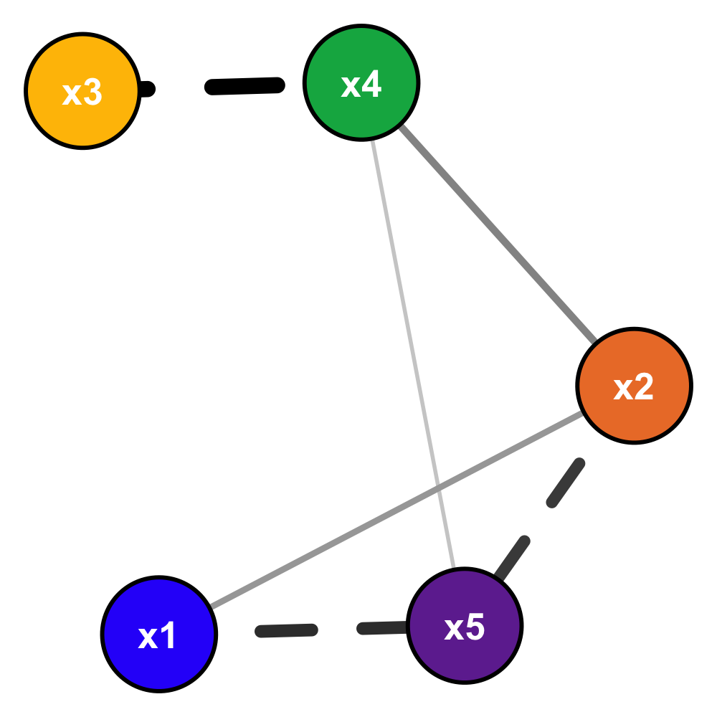
Statistical Methods
Dynamic EGA
d_{V1}
d_{V2}
d_{V3}
d_{V4}
d_{V5}
d_{V1}
0.18
0 | 0
0 | 0.21 | -0.51
-0.40 | -0.37 | 0 | 0.10
d_{V2}
d_{V3}
d_{V4}
d_{V5}
Regularized Partial Correlations

Slide 65
Statistical Methods
Dynamic EGA
Factor Analysis
Dynamic Factor Analysis
psych::fa.parallel(), psych::fa()
d_{V1}
d_{V2}
d_{V3}
d_{V4}
d_{V5}
d_{V1}
0.18
0 | 0
0 | 0.21 | -0.51
-0.40 | -0.37 | 0 | 0.10
Principle Components Analysis
psych::fa.parallel(), psych::pca()
d_{V2}
d_{V3}
Other clustering techniques
d_{V4}
d_{V5}
Regularized Partial Correlations
See Beck & Jackson, 2020

Slide 66
Statistical Methods
Bi/Multivariate: Correlations and (Basic) Structural Models
Factor Analysis
Dynamic Factor Analysis
psych::fa.parallel(), psych::fa()
V1
V2
V3
V4
V5
V1
0.02
-0.05 | 0.08
0.64 | -0.12 | -0.10
0.26 | -0.27 | 0.43 | 0.07
Principle Components Analysis
psych::fa.parallel(), psych::pca()
V2
V3
V4
Other clustering techniques
V5
See Beck & Jackson, 2020
Notes:
which results in a symmetric matrix of the associations among the measured variables,
which many of you may have seen represented using network tools like this
Because this is looking at patterns among an individual's expeirences over time, this could be considered a descriptive test of Allport's contention that personality is a dynamic organization within the individual.
Of course, this doesn't capture how these experiences predict each other over time, so another practice to lag the associations such that the current time point is predicted from previous time point

Slide 67
Exercise 5:
Dynamic Structural Models in dynEGA

Slide 68
Q & A

